Slide 1






AN
ON
S U B M IT T E D
IN
P A R T I A L F U L F I L L M E N T
O F DIPLOMA IN
CHEM ICAL T ECHNOLOGY FERT I LIZER
A N K US H GUPTA
(CHEMICAL TECHNOLOGY FERTILIZER)
GOVERNMENT POLYTECHNIC LAKHIMPUR KHERI SESSION- 2019-20

Slide 2
ACNOWLEDGEMENT
Before presenting the actual matter, I wish tooffermy sincere gratitude to all those who have directly orindirectly helped usin completing this project work.
Weshould liketo express our heartiest respect and greatfulness to Mr. Virendra Kumar (project guide), Mr.P. pankaj (H.O.D), Mrs. Manisha Asthana (Principal) fortheirexcellent guidance and encouragement from time to time by which we found able to present this project report.

Slide 3
CERTIFICATE
It is certified that Ankush Gupta student of diploma in Chemical Technology fertilizer session- 2019-20 of Govt. Polytehnic, lakhimpur kheri has made an equipment design project report entitled “Design of Distillation column”. This report is their own and sole efforts.
Mr. Virendra kumar Mr. P. Pankaj Mrs. Manisha Asthana
(project guide) Govt. polytechnic
(H.O.D)
Department of
(Principal) Govt. polytechnic
Lakhimpur kheri chem. Engineering Lakhimpur Kheri
Govt. polytechnic Lakhimpur Kheri

Slide 4
PREFACE
Chemical industries involve problems in process design, unit operation equipment design and overall plant designing process problems primarily physic-chemical in nature. Unit operation problems are for pure physical, while equipment design problems are to a extent material equipment design is essentially limited to mechanical aspects of design and construction feature of process equipment.
The object of this project report is to design and “Design of Distillation column” This report gives a preview on essential feature which are necessary in designing a column.
Initially basic concept of evaporator is described give an idea of mechanism of evaporator, afterwards various stresses acting of column has been given after this designing procedure has been described in detail. In the last instrumentation and control and safety has reserved its space. Essential figures have been also given to give a better idea of column. I hope the report of mine fulfill purpose and give complete information regarding Evaporator.

Slide 5
CONTENTS
INTRODUCTION
TYPES OF DISTILLATIONPROCESS
BASIC DISTILLATION EQUIPMENT AND OPERATION
DISTILLATION COLUMNINTERNALS
COLUMN REBOILARS
DISTILLATION COLUMNDESIGN
DESAGN PROBLEM
EFFECTS OF NUMBER OF TRAYS OF STAGES
FACTORS AFFECTING DISTILLATION COLUMN OPERATION
INSTRUMENTALION & PROCESS CONTROL
DESIGN PROBLEM
SAFETY
BIBLIOGRAPHY

Slide 6
INTRODUCTION

Slide 7
INTRODUCTION
Distillation is a unit operation in which the constituents of a liquid mixture (solution) are separated using thermal energy. Basically, the difference in vapour pressures (volatilities) of different constituents at the same temperature is responsible for such a separation. This unit operation is also termed as fractional distillation or fractionation. With this technique it is possible to separate the liquid mixture into its components in almost pure form and due to this distillation is the most important of all the mass transfer operations. In distillation, the phases involved are : liquid and vapour (the vapour phase is created by supplying heat to the liquid) and mass is transferred from both the phases to one another, by vaporisation from the liquid phase and by condensation from the vapour phase. The net effect is an increase in composition of the more volatile component in the vapour (phase) and that of the less volatile component in the liquid. The basic requirement foraseparation ofcomponents by distillation isthat the composition of the vapour be different from the composition of the liquid with which it is in equilibrium - the vapour is always richer in the more volatile component than the liquid from which it is formed. If the vapour composition is the same as the liquid composition, distillation technique will not effect a separation. Distillation is commonly used in chemical and petroleum industries as a means of separating the liquid mixture into its component parts. Separation of ethanol and water mixture, production of absolute alcohol from 95% ethanol using benzene, separation of petroleum crude into gasoline, kerosene, fuel oils, etc. are the typical examples of distillation.
The most widely used separation process in the chemical industry is distillation is applied only to those operations where vaporization of a liquid mixture gives a vapour phase containing more than one constituents and it is desired to recover one or more of these constituents in a nearly pure state.

Slide 8
The basic requirement foraseparation ofcomponents by distillation is that the composition if the vapour to be different from the composition isthesame astheliquid composition of distillation process will not effect a separation.
In distillation a vapour phase contacts liquid phase and mass is transferred both from liquid to vapour and from vapour to liquid. The liquid and vapour generally contains some components but in different relative quantities. Mass is transferred symmetrically both from the liquid by vaporization and from the vapour by condensation.
The lower boiling components tend to concentrate in vapour phase while the higher boiling components tend towards theliquid phase. The result is vapour phase that becomes richer in light components asit passes up the column and a liquid phase that becomes richer in heavy components as it cascades downward.
The overall separation achieved between the distillate and the bottoms depend primarily on the relative volatiles of the components, the number of contacting trays, and the ratio of the liquid phase flow rate to the vapour flow rate.
In continuous distillation, which is most widely used, the column is divided in two parts stripping section and rectifying section. The plate in which feed enters is called feed plate. The column above the feed plate called rectifying or entering section and a lower, section, which is often referred to as the stripping section.
Liquid reaching the bottom of the column partially vaporized in aheated Rebuilder to provide boil-up, which issent back uptothecolumn. The remainder of the bottom liquid is withdrawn bottom product. Vapour reaching top of the column is collected and condensed to liquid in the overhead condenser. Part of this liquid over flow, the remainder of the overhead stream is withdrawn as distillate, or overhead product.

Slide 9
PREFACE
Chemical industries involve problems in process design, unit operation equipment design and overall plant designing process problems primarily physic-chemical in nature. Unit operation problems are for pure physical, while equipment design problems are to a extent metical, equipment design is essentially limited to mechanical aspects of design and constriction feature of process equipment.
The object of this project report is to design a DISTILLATION COLUMN This report gives a preview on essential feature, which are necessary in designing a column.
In tidally basic concepts of distillation is described give an idea of mechanism in of distillation. Afterwards various stresses acting of column has been given after this designing procedure has been described in detail. In the last instrumentation and control and safety has reserved its space. Essential figures have been also given to give a better idea of column. l hope the report of mine fulfill purpose and give complete information regarding distillation column.

Slide 10
TYPES OF
DISTILLATION PROCESS

Slide 11
TYPES OFDISTILLATION
There are several types of distillation depending on the procedure andthe instrument setup Each of the distillation type is used for the purification of compounds having different properties. Following are the common types of distillation.
1-Simple or differential distillation
In this distillation technique, a known quantity of a liquid mixture is charged into a keted kettle or still. The jacket is provided for heating the liquid mass in the still with the belp of a heating medium such as steam. The charge is boiled slowly, the vapours formed is ithdrawn and fed to a condenser where it is liquified and collected in a receiver as a distillate. In the early stage of distillation, thevapour, so the distillate, leaving thestill is rich the more volatile component and as the distillation proceeds the liquid in the still becomes with respect to the more volatile component. The composition of the less volatile ionent thereby increases and hence the boiling point increases. The product (distillate) such units can be collected inseveral receivers, called cuts, to give the products ofus purities over the length of distillation period. The distillation is continued till the rig point of the liquid reaches a predetermined value and the content of the still is finally ,ved as residual liquid containing majority of the less volatile component.
In different or simple distillation the vapour generated by boiling the liquid is with drawn from contact with the liquid and condensed as fast as it formed. It is a single stage batch distillation. It is start with a still pot, initially fully heatedataconstant rate. In this process the vapour from one

Slide 12
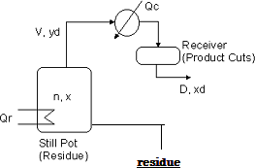
ofthe boiling liquid is removed at once from thesystem since thevapour is richer in more volatile component. The liquid remaining becomes weaker in this component regularly volatile component.
Though the simple or differential distillation as a method of separation is not effective, many such units are used, especially where the components to be separated have widely different boiling points and methods giving sharp separations are not necessary.
Simple distillation is practiced fore mixture in which the boiling point the components differ by at least 70°c. it is also followed for the mixture Contaminated with in volatile particles (solid or oil) and those that are nearly pure with less than 10 percent contamination. Double distillation is the process of repeating distillation on the collected liquid in order to enhance theseparated compound.
2-Flash or equilibrium distillation
Flash distillation is normally carried out in a continuous manner. In this method, a liquid ture is partially vaporised, the vapour and liquid are allowed to attain equilibrium by viding a sufficient contact time and finally withdrawn separately. Feed is heated in a tubular heat exchanger. The hot liquid mixture is then fedtoa arator viaa pressure reducing valve whereby

Slide 13
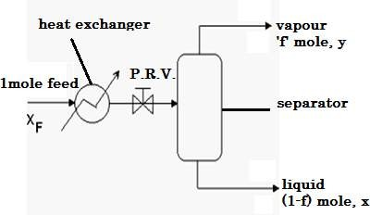
pressure is reduced and the vapour is formed the expense of liquid adiabatically. The liquid is withdrawn from the bottom of the arator and the equilibrium vapour leaves the separator from the top which is then liquified a condenser. Flash distillation is commonly used in petroleum industry, handling multi mponent systems in the pipe stills.
Equilibrium distillation involves definite of a batch liquid, keeping all the liquid and all the vapour in intimate contact so that at the end of the operation the vapour is in equilibrium with the liquid with drawing the vapour of condensing it. This method is used in multi component system in oil refining, however where petroleum mixture are heated underpressure
in pipe still, (entering temp. of crude oil is 440 k & pressure is 900 kg/m²)
and leaves at 500 k and a pressure of only 400 kg/m² and the vapour flashed under approximately equilibrium condition from thesuper heated liquid.
Consider one mole of a liquid mixture having xF mole fraction of the more volatile component, is fed to a flash distillation unit. Let 'f be the fraction of

Slide 14
thefeedthat isvaporised and is ofcomposition 'y'. Then, (1 — f) will be the moles of the residual liquid obtained. Let be the mole fraction of the more volatile component in the liquid.
Then, the material balance of the more volatile component is
X_{F} = f . y +(1 – f) . x
y = -(1-f)x/f + X_{F/}f
the above equation is the material balance/operating line for flash distillation with a slope equal to — (1 — f)/f and an intercept equal to xF/f.
the point of intersection oftheoperating line andthe diagonal ( x = y) is (x_{F =} y_{F} )
y = -(1-f)x/f + X_{F/}f x = y
x = -(1-f)x/f + X_{F/}f
so,
x =X_{F}
and y = X_{F}
for f = 1, feed totally vaporized (feed 100 mole percent vaporized)

Slide 15
Slope = -(1-f)/f = 0
And hence the operating line is parallel tox-axis through point (X_{F,}X_{F}) on the diagonal.
For f = 0, no feed is vaporized.
Slope =-(1-f)/f = infinite, and the operating line will be parallel to y-axis through a point (x_{F =} y_{F} ) on the diagonal.
Flash distillation (sometimes called" equilibrium distillation") is a single stage separation technique. A liquid mixture feed is pumped through a heater to raise the temperature and enthalpy of the mixture. it then flows through a valve and the enthalpy of the mixture . it then flows through a has the equilibrium composition given by point c, approximately 0 8 un fraction A this is approximately 50%richer in A than the original liquid.
3-Fractional distillation
A fractionating column or fractionator consists of (i) a cylindrical shell divided into sections byaseries of perforated trays, (ii) a reboiler and (iii) a condenser. The liquid mixture to be separated is introduced in the cylindrical column more or less centrally. The column itself is divided into twosections - rectifying andstripping section. The section above the feed plate or tray is called the rectifying section, wherein the vapour is washed to remove the less volatile component with the liquid returned to the column from top (known as reflux). The portion below the feed plate including the feed plate is called the stripping section wherein the liquid is stripped off more volatile component by rising vapour. Perforated trays are nothing but gas-liquid contacting devices on which gas/vapour and liquid are brought into intimate contact for mass transfer to occur.
Vapours are generated ina reboiler (generally steam heated) and are fed to the bottom of the column. The liquid removed from the fractionator rich intheless volatilecomponent iscalled the bottoms orbottom product. The vapour issuing from the top of the column is fed to a condenser where the

Slide 16
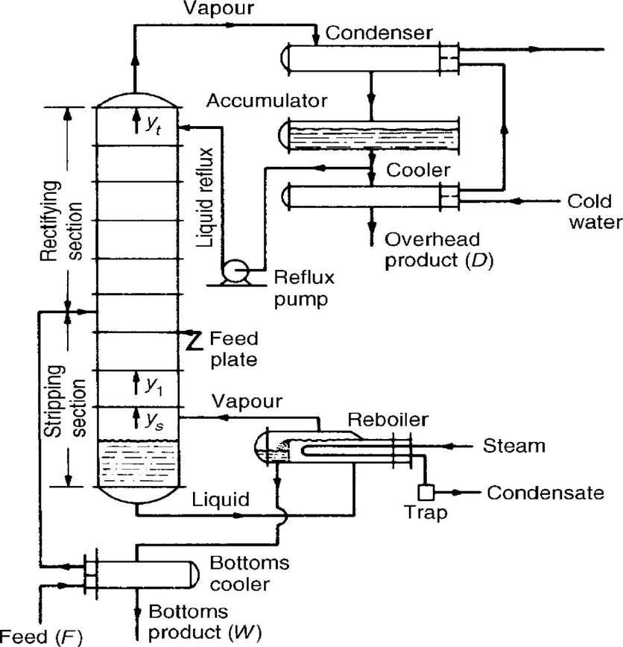
latent heat is removed with the help of a circulated coolant through the condenser. A part of the condensed liquid is returned to the column (reflux) and the remaining part is withdrawn as the top product or distillate which is rich in the more volatile component. As we move up the column, thevapour becomes richer and richer inthemore volatile component and as we move down the column, the liquid becomes richer and richer in the less volatile component. As the liquid is at its bubble point and the vapour is at its dew point, temperature is maximum at the bottom and minimum at the top. The part of the condensed liquid returning to the top of the column is called as reflux.

Slide 17
In analysing the operation on each tray it is important to note that the vapour rising to it, and the reflux flowing down to it, are not in equilibrium, and adequate rates of mass and heat transfer are essential for the proper functioning ofthe tray. The tray as described isknown asasieve tray andit has perforations of up to about.
12 mm diameter, although there are several alternative arrangements for promoting mass transfer onthe tray, such asvalve units, bubble caps and other devices described in Section 11.10.1. In all cases the aim is to promote good mixing of vapour and liquid with a low drop in pressure across the tray. On each tray the system tends to reach equilibrium because.
Some of the less volatile component condenses from the rising vapour into the liquid thus increasing the concentration of the more volatile component (MVC) in the vapour.
Some of the MVC is vaporised from the liquid on the tray thus decreasing the concentration of the MVC in the liquid. The number of molecules passing in each direction from vapour to liquid andin reverse is approximately the same since the heat given out by one mole of the vapour on condensing is approximately equal to the heat required to vaporise one mole of the liquid. The problem is thus one of equimolecular counter diffusion.
Ifthemolar heats ofvaporisation are approximately constant, the flows of liquid and vapour in each part of the column will not vary from tray to tray. This is the concept of constant molar overflow which is discussed under the heat balance heading in Section 11.4.2. Conditions of varying molar overflow, arising from unequal molar latent heats of the components, are discussed in Section 11.5.In the arrangement discussed, the feed is introduced continuously to the column andtwo product streams are obtained, one at the top much richer than the feed in the MVC and the second from the base of the column weaker in the MVC. For these separation of small quantities of mixtures, a batch still may be used. Here the column rises directly from a large drum which acts as the still and reboiler and holds the charge of feed. The trays in the column form a rectifying column and distillation is continued until it is no longer possible to obtain the desired product quality from thecolumn. The concentration

Slide 18
of the MVC steadily falls in the liquid remaining in the still so that enrichment tothe desired level of the MVCisnot possible. This problem is discussed in more detail in Section 11.6. A complete unit will normally consist ofafeed tank, afeed heater, acolumn with boiler, acondenser, an arrangement for returning part of the condensed liquid as reflux, and coolers to cool the two products before passing them to storage.
The reflux liquor may be allowed to flow back by gravity to the top plate of the column or, as in larger units, it is run back to a drum from which it is pumped to the top of the column. The control of the reflux on very small units is conveniently effected by hand-operated valves, and with the larger units by adjusting the delivery from a pump. In many cases the reflux is divided by means of an electromagnetically operated device which diverts the top product either to the product line or to the reflux line for controlled time intervals.
11.4.2. Number of plates required in a distillation column
In order to develop a method for the design of distillation units to give the desired fractionation, it is necessary, in the first instance, to develop an analytical approach which enables the necessary number of trays to be
calculated. First the heat and material flows over the trays, the condenser,
and the reboiler must be established. Thermodynamic data are required to establish how much mass transfer is needed to establish equilibrium between the streams leaving each tray. The required diameter of the column will be dictated by the necessity to accommodate the desired flowrates, to operate within the available drop in pressure, while at the same time effecting the desired degree of mixing of the streams on each tray.
Four streams are involved in the transfer of heat and material across a plate, as shown in Figure 11.12 in which plate n receives liquid Ln+1 from plate n + 1 above, and vapour Vn−1 from plate n − 1 below. Plate n supplies liquid Ln to plate n − 1, and vapour Vn toplate n + 1.
The action of the plate is to bring about mixing so that the vapour Vn, of composition yn, approaches equilibrium with the liquid Ln, of
composition xn. The streams Ln+1 and Vn−1 cannot be in equilibrium
and, during the interchange process on the plate, some of the more volatile component is vaporised from the liquid Ln+1, decreasing its concentration to xn, and some of the less volatile component is condensed from Vn−1, increasing thevapour concentration to yn. The heat required to vaporise the more volatile component from the liquid is supplied by partial condensation of

Slide 19
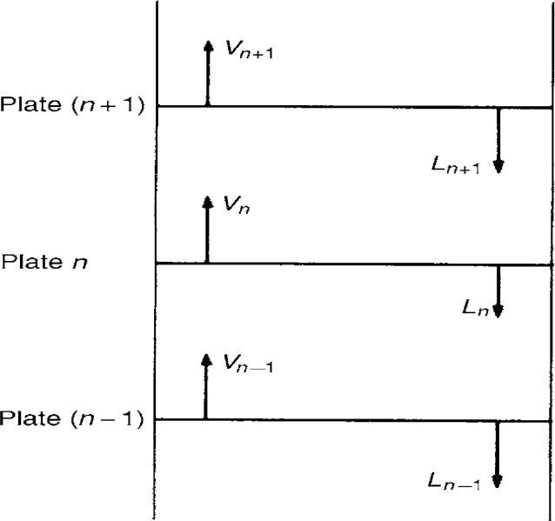
the vapour Vn−1. Thus the resulting effect is that the more volatile component is passed from the liquid running down the column to the vapour rising up, whilst the less volatile component is transferred in the opposite direction.
Heat balance over a plate
A heat balance across plate n may be written as:
Ln+1HLn+1+Vn−1HVn−1= VnHVn+LnHLn+ losses + heat of mixing(11.32 where: HL n is the enthalpy per mole of the liquid on plate n, and HV n is the enthalpy per mole of the vapour rising from plate n. This equation is difficult to handle for the majority of mixtures, and some simplifying

Slide 20
assumptions are usually made. Thus, with good lagging, the heat losses will besmall and may be neglected, and foranideal system theheatof mixing iszero. For such mixtures, the molar heatofvaporisation may be taken as constant and independent of the composition. Thus, one mole of vapour Vn−1 on condensing releases sufficient heat to liberate one mole of vapour Vn. It follows that Vn = Vn−1, so that the molar vapour flow is constant up the column unless material enters or is withdrawn from the section. The temperature change from one plate to the next will be small, and HL n may be taken as equal to HL n+1. Applying these simplifications to equation 11.32, it is seen that Ln = Ln+1, so that the moles of liquid reflux are also constant in this section of the column.
Thus Vn and Ln are constant over the rectifying section, and Vm and Lm
are constant over the stripping section.
For these conditions there are two basic methods for determining the number of plates required. The first is due to SOREL(25) and later modified by LEWIS(26), and the second is due to MCCABE and THIELE(27). The Lewis method is used here for binary systems, and also in Section 11.7.4 for calculations involving multicomponent mixtures. This method is also the basis of modern computerised methods. The McCabe–Thiele method is particularly important since it introduces the idea of the operating line which is an important common concept in multistage operations. The best assessment of these methods and their varioWhen the molar heat of vaporisation varies appreciably and the heat of mixing is
no longer negligible, these methods have to be modified, and alternative techniques are discussed in chapter.
Calculation of number of plates using the Lewis–Sorel method If a unit is operating asshown in Figure 11.13, sothat a binary feed F is distilled to give a top product D and a bottom product W, with xf , xd, and xw asthecorresponding mole fractions ofthe more volatile component, andthevapour Vt rising from thetop plate is condensed, and part is run back as liquid at its boiling point to the column as reflux, the remainder

Slide 21
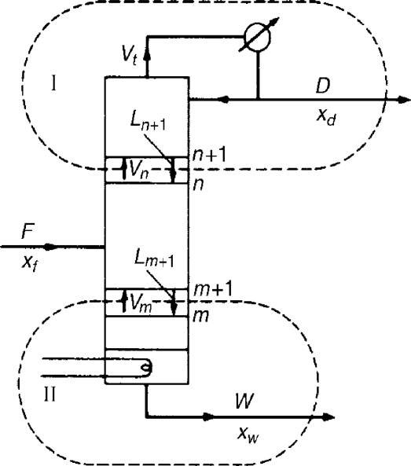
being withdrawn as product, then a material balance above plate n, indicated by the loop I in Figure 11.13 gives:
Vn = Ln+1 +D
Figure 11.13. Material balances at top and bottom of column
Expressing this balance for the more volatile component gives:
ynVn = Ln+1xn+1 + Dxd
Thus:
yn= Ln+1Vnxn+1 + DVn xd
(11.34)

Slide 22
This equation relates thecomposition of the vapour rising tothe plate to thecomposition of theliquid onany plate above thefeed plate. Since the molar liquid overflow is constant, Ln may be replaced by Ln+1 and: yn = LnVnxn+1 + DVnxd (11.35)
Similarly,takingamaterial balanceforthetotal streams andforthe more volatile
component from the bottomto above plate m, asindicated bytheloop II in Figure 11.13,
and noting that Lm = Lm+1 gives:
Lm = Vm +W (11.36)and: ymVm = Lmxm+1 −Wxw Thus: ym = LmVmxm+1 − WVmxw (11.37)
This equation, which is similar to equation 11.35, gives the corresponding relation between thecompositions of the vapour rising toa plate and the liquid on the plate, for the section below the feed plate. These two equationsarethe equationsoftheoperatinglines.Inordertocalculatethe change incomposition from one plate tothe next, theequilibrium data are used to find the composition of the vapour above the liquid, and the enrichment line to calculate the composition of the liquid on the next plate. This method may thenbe repeated up the column, using equation
11.37 for sections below the feed point, and equation 11.35 for sections above the feed point.
The method of McCabe and Thiele
The simplifying assumptions of constant molar heat of vaporisation, no heat losses, and no heat of mixing, lead to a constant molar vapour flow and a constant molar reflux flow in any section of the column, that is Vn
=
Vn+1, Ln = Ln+1, and so on. Using these
simplifications, the two enrichment equations are obtained:
yn = LnVn xn+1 + DVn xd (equation 11.35)
and: ym = LmVm xm+1 – W Vm xw (equation 11.37)
These equations are used in the Lewis–Sorel method to calculate the relation between the composition of the liquid on a plate and the composition of the vapour rising to that plate. MCCABE and THIELE(27) pointed out that, since these equations represent straight
lines connecting yn with xn+1 and ym with xm+1, they can be drawn on
the same diagram as the equilibrium curve to give a simple graphical solution forthe number of stages required. Thus, the line of equation

Slide 23
11.35 will pass through the
points 2, 4 and 6 shown in Figure 11.14, and similarly the line of equation
11.37 will pass through points 8, 10, 12 and 14. If xn+1 = xd in equation 11.35, then:
vnyn = Lnxd +
D xd = xd (11.38)
and this equation represents a line passing through the point yn = xn+1
= xd. If xn+1 is put equal to zero, then yn = Dxd/Vn, giving a second easily determined point. The top operating line is therefore drawn through two points of coordinates (xd, xd ) and (0, (Dxd/Vn)).
For the bottom operating line, equation 11.30, if xm+1 = xw, then:
ym = Lmvmxw − WVmxw (11.39)
Since Vm = Lm − W, it follows that ym = xw. Thus the bottom operating line passes through the point C, that is (xw, xw), and has a slope Lm/Vm. When the two operating lines have been drawn in, the number of stages
required may be found by drawing steps between the operating line and the equilibrium curve starting from point A. This method is one of the most important concepts in chemical engineering and is an invaluable tool for the solution of distillation problems. The assumption of constant molar overflow is not limiting since in very few systems do the molar heats of vaporisation differ by more than 10 per cent. The method does have limitations, however, and should not be employed when the relative volatility is less than 1.3 or greater than 5, when the
reflux ratio is less than
1.1 times the minimum, or when more than twenty-five theoretical trays are required.
4-Steam distillation- Steam distillation is used for the purification of mixture, in which the components are temperature or heat sensitive, for example, organic Compounds. In the instrument setup, steam is introduced by heating water, which allows the compounds to boil at a lower temperature this way, the continuously. A continuous operation Is used commonly in the industrial applications.
Azeotropic distillation :

Slide 24
Azeotropes
An azeotrope is a mixture of two or more liquids that cannot be separated by distillation. it is also known as a constant boiling mixture. When an azeotrope is boiled, the resultant gaseous from or vapor has the same
:.1/4.)rnposition, or ratio of components as the liquid state, which is why separation isn't possible through distillation. To split up the azeotrope, a material separation agent or entertainer is added, which basically "breaks" azeotrope, various parameters are used to classify azeotropes. Givei below are two ways to classify them.
A positive azeotrope is in which the boiling point is lower than any of its components. An example is a water-ethanol mixture, composed of 95.63%ethanol and 4.37% water by weight. This azeotrope boils at 78.2c'c c;h is lower than that of water (100°c) or ethanol (78.4'c) this azeotrope caked a minimum boiling mixture, ar a pressure maximum azeotuL,...t. . conversely an azeotVrop is negative, if its boiling point is hydrochloric acid 20.2% and 79.8% water (by weight). The boiling point of this azeotrop 110°c which is highert hanthat of water as well a61-iydrogen chloride. Negative azeotropes are also called maximum boiling mixture or pressure mitthmirri azeotropes.
Number of components
most azeotropes are binary (made up of two constituents) or tenary (maade up of three constituents) though they can be mode of more then three constituents as well.
Entrainers
This is a substance that is added to an azeotrope to facilitate the separation. A specific entrainer has to be identified for the process of azeotrope distillation, as not all entrainers will work with a given azeotrope. A residoal curve map is used to identify which entrainer is suitable. ,:a r-11. ►■;. e4re divided into different types, depending on the function tileperform to enable the separation:
Entrainers that react with one of the components of the azeotrope El:trainers that induce a liquid-phase separation El trainers that ion ically

Slide 25
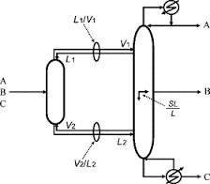
dissociate o►ltrainers that do not cause a liquid phase separation There are different types of azeotropic distillation as well, like homogeny - eoias and heterogeneous azeotropic distillation. Homogeneous azeotropic distillation is a- separation process of azeotropes where the entrainer completely miscible with the liquid. Depending on whether a single corn - ponent or all the components of as azeotrope need to be separated, continuous distillationis carried out, until the desired constituent is achieved.Inheterogeneousazeotropicdistillation,theentrainerwillform
n azrotrope with one or more of the components of the initial azeotropic mixture, enabling separation of the remaining constituent by a distillation sequence.
Azeotrupic distillation is an important process in chemical engineering. Understanding the terms used in the discussion of azeotropic distillation will give you the ability to grasp the intricacies of this topic.
Distillations defined as:
A process in which a liquid orvapour mixture of twoor more substances is separated into its component fractions of desired purity, by the application and removal of heat.
Distillation is based on the fact that the vapour of a boiling mixture will be richer in the components that have lower boiling points. Therefore, when

Slide 26
this vapour is cooled and condensed, the condensate will contain more volatile components. At the same time, the original mixture will contain more of the less volatile material.
Distillation columns are designed to achieve this separation efficiently.
Although many people have a fair idea what "distillation" means, the important aspects thatseem tobe missed from the manufacturing point of view are that distillation is the most common separation technique.
it consumes enormous amounts of energy both in terms of cooling and heating requirements it can contribute to more than 50% of plant operating costs 'le Lest: way to reduce operating costs of existing units, is to improve their efficiency and operation via process optimization and control. To achieve this improvement, a thorough understanding of distillation principles and how distillation systems are designed is essential.
The boiling pointdiagram
shows how the equilibrium compositions of the components in a liquid mixture very with temperature at a fixed pressure consider an example of a liquid mixture containing 2 components (a and b)- a binary mixture . this has the following Boiling point diagram.

Slide 27
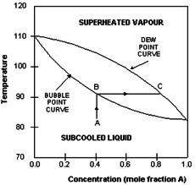
The boiling point of a Is that at which the mole fraction of a is 1_ The boiling point of b is that at whic h the mole fraction of b is 0. In ti example A Is the more volatile component and therefore has a tower boiling point than b. the upper curve in the diagram is called the dew- point curve while the lower one is called the bubble-point curve. tiew-poiLl. Is the tarnperature at which the saturaded vapour ::;..arts to condense. Trie bubble-point is the temperature at which the liquid starts to boil. The region above the dew- point curve shows the equilibrium composition of the superheated vapour while the rigion below the bubble- point curve
,:lows the equilibrium composition of the subcooled liquid.
For example, when asubcooled liquid with mole fraction of A=0. 4(pointAl is heated , its concentration remains constant until it reaches the bubble-peint(pcintB) when it starts to boil . thevapours evolved during the boiling higher boiling points.
Tray designs
A tray essentially acts asa mini- column, each accomplishing a fraction of the separation task. From this we can deduce that the more trays there are, k " i-- the degree of separation and that overall separation afficiency wili depend significantly on the design of the tray. Trays are designed to ifiaximize vapour-liquid contactby.

Slide 28
DISTILLATION PRINCIPLES
Separation of components from a liquid mixture via distillation depends oil the differences in boiling points of the individual components. Also depend ing on the concentrations of the components present, the liquid mixture will have different boiling point characteristics. Therefore, distillation processes depends on the vapour pressure characteristics of liquid mixtures.
vapour pressure and boiling

Slide 29
The vapour pressure of a liquid at a particular temperature is the equilib rium pressure exerted by molecules leaving and entering the liquid surface
. here are some important points regarding vapour pressure:
Energy input raises vapour pressure
Vapour pressure is related to boiling
Aiquid issaud to, boil, when its vapour pressure equals surrounding pressure
The ease with which a liquid boils depends on its volatility
LicFirds with high vapour pressures(volatile liquids) will boil at low r temperatures
The vapour pressuPand hence the boiling point of a liquid mixture dependsonthe relative amounts of the components inthe mixture
Distillation occurs because of the differences in the volatility of components in the liquid mixture
Extractive distillation
Extractive distillation is defined as distillation Inthe presence ofa miscible high boiling, relatively non volatile;e component, the solvent, that forms no
:-12.eotiopes with the other components in the mixture. The method is used for mixtures having a low value of relative volatility, nearing unity.

Slide 30
Such mixtures cannot be separted by simple distillation, because the volatility ofthetwocomponents inthe mixture is nearly thesame, causing themto ,aperete, at nearly thesame temperature at asimilar rate, making normal iLtillation impractical.
The method of extractive distillation uses a separation solvent, which is generally nonvolatilie, hasa high boiling point is miscible with the mixture, but doesn't form an azeotropic mixture. The solvent interacts differently components of the mixture theredy causing their relative volatillation to change. This enable the new three-part mixture to be z,epar,,teJ by normal distillation. The original component with the greatest volatilityu separates out as the top product. The bottom product consists of a mixture of the solvent and the other component, which can again be separeited easily because the solvent doesn't form an azeotrope with The bottom product canbe separated byanyof the methods available_ it is important toselect a suitable separation solvent for this type of distillation. The solvent must alter the relative volatility by a wide enough marin for a successful result. The quantity, cost and availability of the solvent should be considered. Solvent should be easily separable from the Pottom product, and should not react chemically with the components or the mixture, or corrosion in the equipment. A classic example to be cited here is the separation an azeotropic mixture of benzene and cyclohexane, where aniline is one suitable solvent.
Batch distillation
Batch distillation refers tothe use of distillation in batches, meaning thata mixture is distilled to separate it into its component fractions before the distillation still is again charged with more mixture and the process is

Slide 31
repeated. This is in contrast with continuous distillation where the feedstock is added and the distillate drawn off without interruption.
batcn distillation has always been an important part of the production cd seasonal, or low capacity and high-purity chemicals. It is a very frequel it separation process in the pharmaceutical industry and wastewater treatment units.

Slide 32
BASIC DISTILLATION EQUIPMENT
AND OPERATION
BASIC DISTILLATION EQUIPMENT AND OPERATION

Slide 33
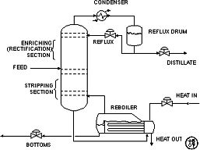
Main components of distillation columns
distillation columns are made up of several components, each of which is used either to transfer heat energy or enhance material transfer. A typical distillation contains several major components;
A vertical shell where the separation of liquid components is carried out
Column internals such as trays/plates and/or packings which are used to enhance component separations
A reboiler to provide the necessary vaporisation for the distillation process
A condenser to cool and condense the vapour leaving the top of the column
A reflux drum to hold the condensed vapour from the top of the column so that liquid (reflux) can be recycled back to column
The vertical shell houses the column internals and together with tih condenser and reboiler, constitute a distillation column. A schematic of a typical distillation unit with a single feedand two product strems isshovvn below

Slide 34
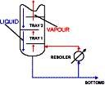

Basic operation and terminology
The liquid mixture that is to be processed is the feed and this is introduci21..i scrnewhere nearthe middle ofthecolumn toa trayknown as feed tray. The feed tray divides the column into a top (enriching oi rectification) section alidabottom (stripping) section. The feed flow!-; chit is the column where it is collected at the bottom in the reboiler.
Heat is .supplied to the reboiler to generate suitable fliud although in n-. cnemical plants this is normally steam. In refineries, tile heating source may be the output streams of other column;:. The vapour raised in the reboiler is re-introduced into the unit at the bottom of the cc umn The liquid removed from the reboiler is known as the bottoms picduct simply. bottorns.The vapour moves up the
column and as it exits the top of the unit, it is cooled by a condenser The con-denscr liquid isstored inaholding vessel known asthe reflux drum.

Slide 35
some of liquid is recycled back to the top of the column and this is called the reflux. The condensed liquid thatis removed from thesystem isknown asthe distillate ortop product. Thus, there are internal flows ofvapour and liquid within the column as well as external flows of feeds and product streams, into and out of the column.
Types of distillation columns
There are many types of distillation columns, each designed to perform specific types of separation, and each design differs in terms of complexity
Batch and continuous columns
one way classifying distillation column type istolook athowthey are Operated. Thus wehave:
Batch and Continuous columns.
Batch columns
In batch operation, the feed to the column is introduced batch-wise. That is. the column is charged with a 'batch' and then the distillation process is carried out. When the desired task is achieved, a next batch of feed is introduced.
continuous columns
In contrast, continuous columns process a continuous feed stream. No interruptions occur unless there is a problem with the column or surrounding process units. They are capable of handling high throughputs the most common of the two types. We shall concentrate only on class of columns.
Types of continuouscolumns
Continuous columns can be further classified according to; The nature of the feed that they are processing,Binary column-feed contains only two components Multi- component column- feed contains more than two components

Slide 36
The number of product streams they have
Multi-product column — column has more thantwo product streams where the extra feed exits when it is used to help with the separation.
Extractive distillation —where the extra feed appears in the bottom product steam
Azeotropic distillation — where the extra feed appears at the top product stream
The type columninternals
Tray column — where trays of various designs are used to hold up the liquid to provide better contact between vapor and liquid, hence better separation
Packed column — where instead of trays, 'packing s' are used to enhance contact between vapor and liquid

Slide 37
DISTILLATION
COLUMN INTERNALS

Slide 38
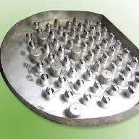
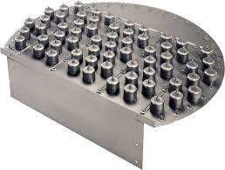
DISTILLATION COLUMN INTERNALS
Trays and Plates
The terms "trays" and "plates" are used interchangeably. There are many types of tray designs, but the most common ones are
Bubble cap trays
A bubble cap tray has riser or chimney fitted over each hole, and a cap that covers the riser.
The cap is mounted sothat there isaspace between riser andcap to allow the passage of vapour. Vapour rises JiluotjH ciie/ and is directed downward b Ui cay finally discharging through slots in the cap, and finally bubbling through the liquid on the tray.

Slide 39

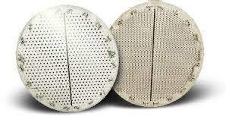
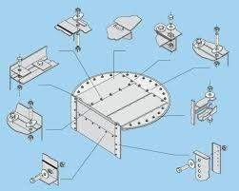
Valve trays
Invalve trays, perforations are covered byliftable caps. Vapour flows lifts the caps, thus self creating a flow area for-, the passage of vapour. The lifting cap directs the vapour to flow horizontally ' into the liquid, thus providing better ot:i.h!rig LLidri is possibie in sieve trays.

Slide 40
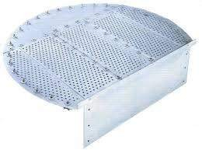
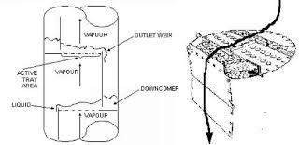
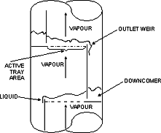
Sieve trays
Sieve trays are simply metal plates with holes in them. Vapour passes strght upward through the liquid on the plate. The arrangement, number and size of the holes are design parameters. Because of their efficiency, wide operating range, case of maintenance and cost factors, sieve and valve trays have R.:placed the once highly thought of bubble cap trays in many applications.
Liquid and Vapour Fiows in a Tray Column
The next few figures show the direction ofvapour andliquid fiovv d i ross a tray, and across a column.

Slide 41

Each tray has 2 conduits, one on each side, called Liquid falls through the downcomers by, gravity fro [heone below it. The flow across each plate is shown in the above diagram on the right.
A weir on the tray ensures that there is always liquid (holdup) cn the tray and is designed Isuch that the the holdup is at a suitable height, e.g. such that the bubble caps are covered by liquid.

Slide 42
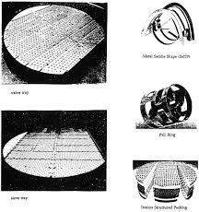
Being lighter, vapour flows up the column and is it,,-...i.d L l..i pass throuili the liquid, via the topenings on each tray. The area allowed for the passage of vapour on each tray active tray area. The picture on the left is a photograph of a section of a pilot scale column equipped with bubble capped trays. The tops of the 4 bubble caps on the tray can just be seen. The down- corner in this case is a pipe, and is shown on the right. The frothing of the liquid on the active tray area due to bolt passage of vapour from the tray below well as boiling.
Asthehottervapour passes through the L:id onthe tray above, it transfers heattotheliquid. In doing so, some ofthevapour condenses adding tothe liquid on the tray. The condensate, however, is richer in the less volatile components than is in the vapour. Additionally, because of the heat input from the vapour, the liquid on the tray boils, generating more vapour. This vapour, which moves up to the tray in the colur;in, is richer in the more volatile I components.
This continuous contacting between vapour and liquid occurs equilibrium stage on each tray inthecolumn and brings abouttheseparation between low boiling point components and high boiling components. This is because better vapour-liquid contact means better separation at each tray, translating to better column performance tray will be required to achieve the same degree of separation. Attendant benefits include less energy usage and lower construction costs.
There is a clear trend to improve separations by supplementing the use
trays by additions of packing’s. Packings are passive devices that are

Slide 43
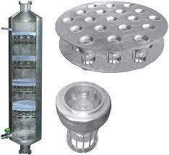
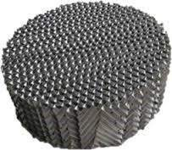
designed to increase the interfacial area for vapour liquid contact. The following picture are shows different types of packing’s.
These strangely shaped pieces proposed to impart good vapour liquid contact.
without causing excessive pressure-drop across a packed section. This is important because a high pressure drop would mean thatgyis required to drive the vapour up the distillation
Structured packing (photo courtesy of Paul Phillips)
Packtings versus Trays

Slide 44
A tray column that is facing throughput problems may be de-bottlenecked by replacing a section of trays with packings. This is because:
packings provide extra inter-facial area for liquid-vapour contact
efficiency of separation is increased for the same column height clzed columns are shorter than trayed columns
Packed columns are called continuous-contact columns while trayed columns are called staged-contact columns because of the manner in which vapour and liquid are contacted.

Slide 45
COLUMN REBOILARS
COLUMNREBOILARS
There are a number of designs of reboilers. It is beyond the scope Lit of introductory notes to delve into their design Iprinciples. However, they can be regarded as heat-exchangers arc required to transfer enough energy to bring the liquid it bottom of the column to boiling boint. The following are examples of typical reboiler types.

Slide 46
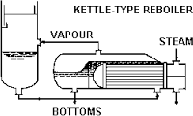
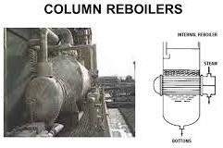
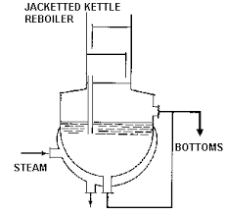
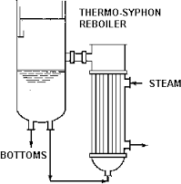
A novel development in reboiler design is the self-cleaning shell-and-tube heat exchangers e7-1 by Klarex Technology for applications where •.. 4 Ltc'uLl'ic.'" heat exchange surfaces are prone to fouling . _Jr (4— by the process fluid. Particles are introduced into the process stream and these produce scouring action on the heat exchange

Slide 47
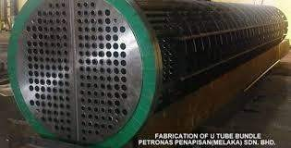
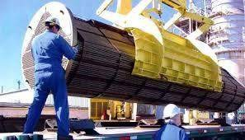
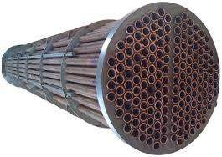
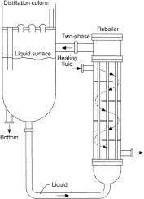
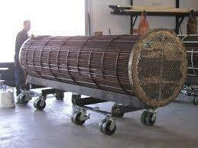
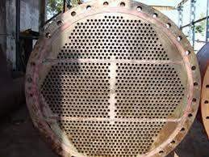

Slide 48
DISTILLATION
COLUM DESIGN
DISTILLATION COLUMN DESIGN
As mentioned, distillation columns are designed using VLE data for the
mixture to be separated. the vapour — liquid equilibrium characteristics (indicated by the shape of the equilibrium curve ) of the mixture will

Slide 49
determine the number of stages and hence the number of trays, required fce- te separation. This is illustrated clearly by applying the mccabe- thiele method to design a binary column.
Mc CASE- THIELE DESIGN METHOD
The McCabe Thiele approach isa graphical one, and uses the VLE plot to determine the theoretical number of stages required to effect the separation binary mixture. It assumes constant molar overflow and this implies that:
Moial heats of vaporisation of the components are roughly the same heat effects (heats of solution, heat losses to and from column, etc )are negligible
For every mole of vapour condensed, 1 mole of liquid is vaporized design procedure is simple. Given the VLE diagram of the binwy mixture, operating lines are drawn first.
Operating lines define the mass balance relationships between liquid and vapour phases in the column.
There is one operating line for the bottom (stripping) saction of the oclemn, and on for the top (rectification or enriching) section of the column.
Use of the constant molar overflow assumption also ensures the the operation lines are straight lines.
Operating fine for the Rectification Section

Slide 50
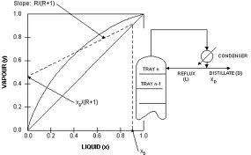
The operating line for the rectification section is constructed as follom.; First the desired top product composition is located on the VLE diagram, and a vertical line produced until it intersects the diagonal line that splits int:: VLE plot in half. A line with Slope R/(R+1) is then drawn from this instersection point as shown in the diagram below.
R is the ratio of reflux flow (L) to distillate flow (D) and is called the ratio and is a measure of how much of the material going up the top of Cle column is returned back to the column as reflux.
Operating line for the Stripping Section
The operating line for tree stripping section is constructed in a similar manner. However, the starting point is the desired bottom product composition. A vertical line is drawn from this point to the diagonal line, and a line of slope Ls/Vs is drawn as illustrated in the diagram below.

Slide 51
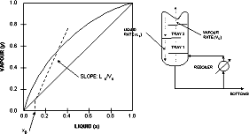
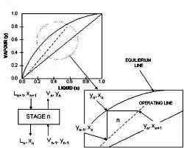
Ls is the liquid rate down the stripping section of the column, while Vs is thevapour rate up thestriping section ofthecolumn. Thus theslope of the operating line for the stripping section is a ratio between the liquid and vapour flows in the column.
Equilibrium and operating lines
The McCabe_ thiele method assumes that the liquid on a tray and ti-;f:- vapour above it are in equilibrium. How this is related to the VLE plot arc' the operating lines is depicted graphically in the diagram on the right.

Slide 52
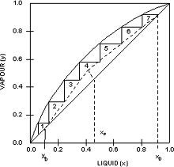
A magnified section of the operation line forthestripping section isshown in relation to the correspoiding n' th stage in the column. L' are the liquid V's are the, vapour flows. X and y denote liquid and vapour compositions and the subscripts denote the origin of the flows or composi tion. That is 'n-1' will mean from the stage below stage 'n' while 'n-4-1' will mean from the stage above stage 'n' and the vapour a hove it are in equilibrium, therefor, Xn and Yn lie of l the equilibrium line. Since the vapour is carried to the tray above witout changine composition, this is depited as a horizonatal line on the VLE plot. 11:-, intersection with the operating line will o give the composition of the liquid on
0.2 0.4 0.8 02 10 •'f, tray 'n+1' as the operating line defines the material balance onthetrays. The composition ofthevapour above the ‘n+1' tray is obtained from the intersection of the vertical line from this point to the equilibrium line.
LIQUID IA

Slide 53
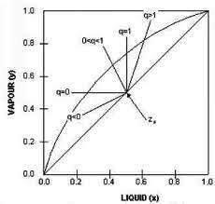
Number of Stages and trays
g tile graphical consruction repeatedly will give rise toa number c:'corner' sections, and each section will be equivalent to a stage of the distillation. This is the basis of sizing distillation column using the McCabe Thiele graphical design methodology as shown in the following example.
Given the operating lines for both stripping and rectification section, the graphical construction described above was applied. This particular e,<;:mrle shows that 7 theoretical stages are required to achieve the desired separation. The required number of trays (asopposed ki stages) is one less then the number of stages sincethe graphical construction includes the contribution of in carrying out the separation.
The actual number of trays required is given by the formula:

Slide 54
(Number of theoretical trays)/(tray efficiency)
Typical values for tray efficiency ranges from 0.5 to 0.7 and depends on a number of factors. such asthe type of trays being used, andinternal liquid andvapour flow conditions. Sometimes, additional trays are added (up to 10%) to accommodate the possibility that the column may be under- designed.
The feed line(q-line)
The diagram above also shows that the binary feed should be introduced at the 4 th stage. However, if the feed composition is such that it does not coincide with the intersection of the operating lines, this means that the feedisnotasaturated liquid. thecondition o9fthefeedcan be deduced by the slope of the feed line or q-line. the q-line is that drawn between the intersection ofthe operating lines, and where thefeedcomposition lies on the diagonal line.
Depending on the state of the feed, the feed lines will have
Different slopes. For example,
Q=0(saturatedvapour) Q=1(saturatedliquid)
O<q<1(mix of liquid and vapour)
Q>1(subcooled liquid) Q<0(superheated vapour)
The q-line for the various feedconditions are shown inthe diagram on the left.

Slide 55
Using operating lines and the feed line in McCabe-Thiele design
Lf we have information about thecondition ofthe feed mixture, then we cup construct the q-line and use it in the McCabe-Thiele design. However, excluder g the equilibrium line, only two other pairs of lines can be used in the McCabe-thiele procedure. These are:
Feed-line and rectification section operating line
Feed-line and stripping section operating line
Stripping and rectification operating lines
This is because these pairs of lines determine the third.
Overall column design
the number of stages required for the desired degree of I 1.-ztaparz-Ition and the location of the feed tray is merely the first steps in producing an overall distillation column design. Other things thatneed tobeconsidered are tray spacing’s column diameter; internal configurations, heating and cooling duties. All of these can lead to conflicting design parameters. Thus, distillation column design is often an iterative procedure. If the conflicts are riot resolved at the design stage, then the column will not perform well in practice. The next set of notes will discuss the factors that can affect distillation column performance.

Slide 56
INSTRUMENTALION
&
PROCESS

Slide 57
INSTRUMENTATION & PROCESS CONTROL
Process may be controlled more precisely to give uniform and higher quality products by the application control, often leading to higher profits. Additionally processes which respond to be controlled by human operators can be controlled automatically it is also beneficial in certain remote hazardous on routineoperation.
The economic return reduced operating cost, maintenance and specification along with improved process operation and increase through put.
Temperature Measurement
For industrial use gas filled system thermometers are extensively used to the following reasons, the snagged construction minimizing the possibility of damage. In case of system failure, the entire unit must be replaced or repaired. The mixing temperature is more limited than in some electrical measuring devices. The capillary allows considerable separation between the point of temperature indication. These devices are self contained and need no auxiliary power supply.
Themotion can be amplified byamechanical linage orgearsystem to drive the pointer of temperature indicator.
Pressure measurement
Pressure measuring devices may be divided in to three groups
(i) Those, which are based on the measurement of the height of the column.
which are based on measurement of distrirsllon of an elastic pressure chamber.
Electrical sensing devices.
(ii)
(iii)

Slide 58
The pressure standards in the industrial or controlled laboratory assured with processing plants usually consists of precision mercury column temperature sensitive compounds are separated before decomposition The vapors are collect and condensed in the same way as other distillation types The resultant liquid consists of two phases, water and compoundwhich is then purified by using simple separation of essential oils and perfumes.
Vacuum distillation
Vacuum distillation is a special method of separating compounds at pressu-re lower than the standard atmospheric pressure. Under this condition, the ;pew boil below their normal boiling tern- perature. Hence, vaccurne distillation is best suited for separation of compounds with higher boiling peil Its (more than 200°c), which tendto decompose at their boiling temperature. Vacuum distilla-tion can be conducted without heating tyre mixture, as usually followed in other distillation types. For the separation of aromatic compounds, vacuum distillation types. For the separation of some aromatic compounds, vacuum distillation is used along with steam distillation.
Snort part distillation
Thermal sensitive compounds can also be separated by following short path distillation. In this technique, the separated compounds are condensed immediately without traveling the condenser. The condensed is configured' in a vertical me finer between the heating flask and the collating flask. Sim to vacuum type, the pressure is maintained below the atmospheric pressure. Short path distillation is used for the separation of organic compounds with high molecular weight, especially in the pharmaceutical industries.
Another method of classifying distillation is based on the column type used in the process. There are two types of distillation columns namely, batch and continuous. in the former case, the feed is provided in the batch wise manner, whereas, in the latter type the feed to the column is introduced measurement . a deed weight tester and test gauges depending upon

Slide 59
accuracy required. The auxiliary measurements required are barometric pressure temperature, length and gravitational constant.
The mercury manometer is normally used for pressure up to 25 psi. At higher pressure the height of mercury columns becomes inconvenient. The dead weight testers commonly used for higher pressure. Indicating device is constant spring bourdon tube pressure gauges, materials are selected on the basis of pressure gauge, resistance to corrosion by the process material and effect of temperature of calibration. the most commonly used visual process level device is the gauge. The gauge glass may be thought of as a manometer in which the process fluid level seeks the same elevation as that in the vessel.
In pressurized vessels floats actuated level and shaft mechanism sic frequently used for level measurements. This type of mechanism consists of a hollow mental flat and a lever attached to a rotary shaft which transmits the float motion to the outside the vessel through a rotary seal. Measurements deed wt. Tester and test gauges depending upon accuracy required. Tile auxiliary measurements required are barometric pressure temperature, length gravitational constant. The mercury manometer is normally used for pressure up to 25 psig At higher pressure the height of mercury columns becomes inconvenient The dead weight testers commonly used for higher pressure. Indicating device is constant spring bourdon tube pressure gauges, materials are :A-lected on the basic of pressure gauge, resistance to corrosion by the pi ucess material and effect of temperature of calibration.
Level Measurement
The most commonly used visual process level device is the gauge. The gauge glass may be thought of as a manometer in which the process flu level seeks the same elevation as the vessel.
In pressurized vessels floats actuated level and shaft mechanism are frequently used for level measurements. This type of machismo consists of a hollow mental float and a liver attached to a rotary shaft which transmits the Float motion to the outside the vessel through a rotary seal.

Slide 60
DESIGN
PROBLEM

Slide 61
PROBLEM-1
A continuous fractionation column operation at 147 psi is to be designed to separate 30000 lb/hr of a solution for Benzene and Toluene, containing 0.97 mass fraction Benzene and a bottom product containing
0.99 mass fraction Toluene. A reflux ratio of 3.5 lb of reflux per round of product is to be used. The feed will be liquid at its boiling point, and the reflux will be returned to the column at 100 F.
A-Determine the quantity of top and bottom products.
B-Calculate the condenser duty and the rate of heat input to the rebuilder.
C-The number of theoretical plates required and the correct feed location.
D-The cooling water required if the water enters the condenser at 80 and leaves at 120 f
F- The quantity of steam required if saturated steam of 35 psi is used as the heating medium in the rebuilder.
SOLUTION
a- Taking material balance
F= D+W (1)
Taking component balance
30000* 0.4 = 0.97 DOMESTIC +0.02 W
120000 = 0.97 ( F –W) +0.02 W
120000 = 0.97*30000 – 0.97 + 0.02 W W =
180000 lb
D = 120000 lb

Slide 62
b-q_{cd} = (R+1) (H₁+H_{d})
from graph
h_{f} = 73.5 Btu/lb; h_{o} = H_{d} = 28.7 Btu/lb H₁= 232.0
Btu/lb ; R=3.5
q_{c}/d = (35+1)(9232.00.28-7) =915
qc = 915*12000 = 10000000 Btu/hr
and taking energy balance
q_{r} = D.H_{d} +W H_{w} + qc –F.H_{f} Where
H_{d} = 28.7 Btu/lb
=344000 + 1559000 + 11000000 – 2205000

Slide 63
= 1069800 Btu/hr
b- from the above date, plot the points (x_{D}, H_{d}). (x_{f}, H_{f}) and (x_{w}, H_{w}) on the enthalpy composition diagram. The point (x_{d} ,h_{d} +q_{cd}) is located next
q_{cd} = 915 Btu/lb ; H_{d} = 28.7 Btu/lb
H_{d} + q_{cd}
= 28.7 + 915944 Btu/lb
Construct the line joining the point (x_{d}, H_{d}+q_{cd}) and (x_{f}, H_{f}) and determine it intersection with line x=x_{w}. The point of intersection is (x_{w},h_{w}-q_{rw}). From diagram it is foun that h_{w}
H_{w} –q_{rw} = - 50 Btu/lb
The graphic solution for the theoretical started either at the top at the bottom of column.
plates be

Slide 64
In fig. The construction was started at the top, and it is found that introduction of the feed is the sixth theoretical plate from the top.
Where reboiler is used , it is customary to assume that the vapour and liquid leaving the reboiler are in equillibrium, although this may not always be true.
Consequently, the reboiler is counted as one theoretical plate, and ten theoretical plate are respected in the column.
d –
q_{c} = 11000000 Btu/hr.
therefore
condenser water rate = 11000000 / (120-80) = 275000 lb/hr
e- q_{r} = 10700000 Btu/hr. from steam tables, saturated steam at 49.7 psi a latent heat of evaporation of 924 Btu/lb. Assuming
that condensate from the reboiler heating surface is removed as saturated liquid,

Slide 65
PROBLEM –2
the steam consumption will be steam = 10700000/924 = 11600 lb/hr
A mixture of 40% by mole Benzene and 60 % by mole Acetone to be rectified continuously. It is desired to obtained and overhead
distillate containing not less than 99.0% by mole Benzene and a bottom product containing not more than the min. reflux ratio are used. Plate efficiency 60% . assumes that feed enter at its boiling point. Calculate –
(i) Min. reflux
(ii)
No. of theoretical & actual plate required

Slide 66
Data given
x | y
5.81% | 12.78%
15.78% | 30.43%
25.60% | 45.28%
32.60% | 59.50%
50.77% | 72.07%
65.89% | 82.97%
82.27% | 92.23%
100.00% | 100.00%
SOLUTION
R_{min} =x_{d} –y/y-x By graph
X_{d} = 0.99
X = 0.40
Y = 0.64
R_{min} = (0.99 –0.64) / (0.64-0.40)
= 1.466
Reflux ratio = 146 + 1.46*50/100 R = 2.29

Slide 67
Intersects of upper operation line Intersects = x_{d}/R+1
= 0.99/2.29+1
= 0.3
No. of theoretical plate required No. of actual plate required = 17-1
= 16
plate efficiency = 60 %
Actual plate required = 16/60*100
= 17
=26.6 plates = 27 plates.
PROBELEM- 3
A binary mixture of isopropyl alcohol n-butaynol is to be separated into its components is a distillation column equipied with a totally condenser and a partial rebuilder the condenser are specified below feed saturated liquid composition is term of mass fraction of more volatile component.
Feed = 0.33
Distillate = 0.997
Bottom = 0.05 Reflux ratio = 1.7

Slide 68
Relative volatility = 2.7
SOLUTION-
Given data
Feed rate = 13000 Kg/hr
More volatile component is isopropyl alcohol and less volatile is n- butane .
Takingoverall material balance F = D + W
13000 = D + W ……(1)
Taking component balance X_{F}.F = X_{D}.D + X_{W}.W
0.33x13000 = 0.997xD + 0.05Xw
Putting thevalue of W from the above equation (1) So, D = 3843.717 Kg/hr
W = 9156.283 Kg/hr
Andinterceptony axisforrectifyingsectionisequaltoX_{D}/(R+1).
So intercept = 0.997/(1.7 + 1) =0.369
The relation between compositions and relative volatility is y = x/[1+(-1)x]
= 2.7x/[1+ 1.7x]
From the above the equation, we generate the value of x and y .

Slide 69
x | 0 | 0.1 | 0.2 | 0.3 | 0.4 | 0.5 | 0.6 | 0.7 | 0.8 | 0.9 | 1.0
y | 0 | 0.23 | 0.40 | 0.53 | 0.64 | 0.72 | 0.81 | 0.86 | 0.91 | 0.96 | 1.0

Slide 70
EFFECTS OF NUMBER OF
TRAYS OR STAGES
EFFECTS OF NUMBER OF TRAYS OR STAGES
Here we will expand on the design of column s by looking briefly at the effects of
The number of trays, and
The position of the feed tray, columns.

Slide 71
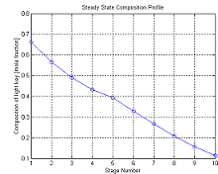
On the performances of distillation columns.
Effects of the number of trays
It can be deduced from the previous section on distillation column design That thenumber of trays will influence the degree ofseparation This is illustrated by the following example.
Consider as a base case, a 10 stage column. The feed is a binary mixture that has a compositions of about 0.65 at the top (stage 1) and 0.1 at the bottom (stage 10) are shown below.
Composition profile: 10stages, feed at stage 5
Suppose we decrease the number of stages to 8, and keep thefeed at the middle stage, i. e.stage 4. The resulting composition
Profile is :

Slide 72
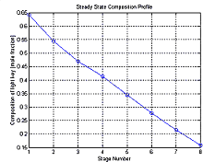
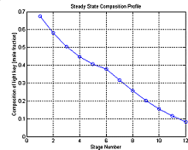
Composition profile: 8 stages, feed at stage 4
We can see that the top composition has deceased while the bottom composition has increased. That separation is poorer.
Now, if we increase the number of stages to 12, and again introduce the fee3d at mid-column. I,e, stage 6, the composition profile we get is:
Composition profile:12 stages, feed at stage 6

Slide 73
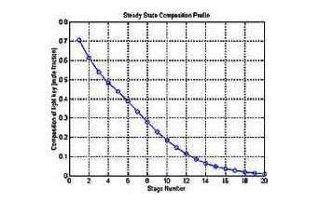
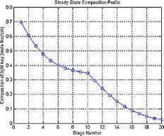
Again, the composition has changed. This time the distillate is much richer in the more volatile component, while the bottoms has less, indicating better separation.
Thus, increasing the number of stages will improve separation. Effect of feed tray position
Here we look at how the position of the feed tray affects separation efficiency. Suppose we have a 20 stage column, affects separating a binary mixture that has a composition of 0.5 mole fraction in terms of the more volatile component. The terminal composition obtained when the feed is introduced atstage 5. 10 and 15 (at fixed reflux and recoil rates) are shown in the following plots.
Composition profile: 20 stage, feed at stage 5
Cure ,position profile: 20 stages, feed at stage 10

Slide 74
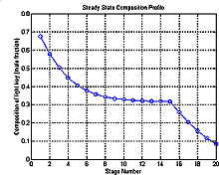
Composition profile: 20stages, feed at stage 15
As the feed stage is moved lower down the column, the top composition becomes less rich in the more volatile component while the bottoms contains more of the more volatile component. However. the changes in top composition is not as marked as the bottoms composition. The preceding examples illustrate what can happen if the position of the feed tray is shifted for this particular system. They should not be used to generalize to other distillation system, as the effects are not straightforward.

Slide 75
FACTORS AFFECTING
DISTILLATION COLUMN OPERATION

Slide 76
FACTORS AFFECTING DISTILLATION COLUMN OPERATION
The performance of a distillation column is determined by many factors, for example: feed conditions
State of feed
Composition of feed
Trace elements that can severely affect the VLE of liquid mixtures
Internal liquid and fluid flow conditions state of trays (pickings) weather conditions
Some of these will be discussed below to give an idea of the complexity of the distillation process.
Feed Conditions
The state of the feed mixture and feed composition affects the operating lines and hence the number of stages required for separation. It also affects the location of feed tray. During operation, if the deviations from design specifications are excessive, then the column may no longer be able handle the separation task. To overcome the problems associated with the feed, some column are designed to have multiple feed points when the feed is expected to containing varying amounts of components.
Reflux Condions:-

Slide 77
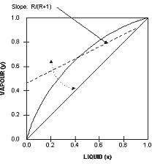
As the reflux ratio is increased, the gradient of operating line for the rectification section moves towards a maximum value of 1. Physically, what this means is that more and more liquid that is rich in the more volatile components are being recycled back into the column. Separation then becomes better and thus less trays are needed to achieve the same degree of separation. Minimum trays are required under total reflux conditions,
i.e. there is no withdrawal of distillate.
On the other hand, as reflux is decreased, the operating line for the rectification section moves towards the equilibrium line. The 'pinch' between operating and equilibrium lines becomes more pronounced and more and more trays are required. This is easy to verify using the McCabe-Thiele method.
The limiting condition occurs at minimum reflux ration, when an infinite number of trays will be required to effect separation. Most columns are designed to operate between 1.2 to 1.5 times the minimum reflux ratio because this is approximately the region of minimum operating costs (more reflux means higher rebuilder duty)
Vaoour Flow Conditions
Adverse vapour flow conditions can cause
foaming

Slide 78
entrainment
weeping/dumping
flooding
Foaming
Foaming refers tothe expansion ofliquid dueto passage ofvapour or gas. Although it provides high interfacial liquid-vapour contact, excessive foaming often leads to liquid buildup on trays. In some cases, foaming may be so bad that the foam mixes with liquid on the tray above. Whether foaming will occur depends primarily on physical properties of the liquid mixtures, but is sometimes due to tray designs and condition. Whatever the cause, separation efficiency is always reduced.
Entrainment
Entrainment refers totheliquid carried by vapour up to the tray above and is again caused by high vapour flow rates. It is detrimental because tray efficiency is reduced owner volatile material is carried to a plate holding liquid of Daher volatility. It could also contaminate high purity distillate. Excessive entrainment can lead to flooding.
Weeping/Dumpinq
This phenomenon iscaused bylow vapour flow. The pressure exerted by the vapour is insufficient to hold up the liquid on the tray. Therefore, liquid starts to leak through perforations. Excessive weeping will lead to dumping. That is the liquid on all trays will crash (dump) through to the base of the column (via a domino effect) and the column will have to be re-started. Weeping is indicated by a sharp pressure drop in the column and reduced separationefficiency.
Flooding
flooding is brought about by excessive vapour Flow, cLusing liquid to be entrained in the vapour up the coins The increased pressure from excessive vapour also back-, up the liquid in the downcomer, causing an increase in liquid holdup onthe plate above. Depending onthe degree of flooding, the maximum capacity of the column may be severely reduced. Flooding is

Slide 79
detected by sharp increases in column differential pressure and significant decrease in separationefficiency.
Column Diameter
Most of the above factors that affect column operation is due to vapour flow conditions: either excessive or too low. Vapour flow velocity is dependent on column diameter. Weeping determines the minimum vapour flow required while flooding determines the maximum vapour flow allowed, hence column capacity. Thus, ifthecolumn diameter isnotsized properly, the column will not perform well. Not only will operational problems occur, the desired separation duties may not be achieved.
State of Trays and Pickings
Remember that the actual number of trays required for a particular separation duty is determined by the efficiency of the plate, and the pickings if pickings are used. Thus, any factors that cause a decrease in tray efficiency will also change the performance of the column. Tray efficiencies areaffectedbyfouling,wearandtearandcorrosion, andtheratesatwhich
...1,±se occur depends on the properties of the liquids being processed. Thus appropriate materials should be specified for tray construction.
Weather Conditions
Most distillation columns are open to the atmosphere. Although many of the columns are insulated, changing weather conditions can still affect column operation. Thus the reboiler must be appropriately sized to ensure that enough vapour can JE.nerated during cold and windy spells and that it can be down sufficiently during hot seasons. The same applies to condensers.
These are some of the more important factors that can cause poor distillation column performance. Other factors include changing operating conditions and throughputs, brought about by ciionqes in LI pstrearn conditions and changes in the demand tot die products. All these factors, including the associated control system, should be considered at the design

Slide 80
stages because onc€- a column is built and installed, nothing much can be doneto rectify thesituation without incurring significant costs. The control of distillation columns is a field in its own right, but that's another story.
SAFETY

Slide 81
SAFETY
It is design proapp nal inspcCtion arc CareliAly
-earn e.ti is expected that theequip-ment should not fail under service condition:; However, failures in service conditions are not entirely eliminated. Singly or in rna.ny• specific causes can lead to these failures
Certhin s,aft-A,/ • can :I:Ls:1p tar pAc SOCh faillArOs In every process
industry a wide variety of preventive and •protectivs:, file%2SUreS must be provided. Such measure can be of two types Measure to minimize or avoid mishaps. 1`.4.aiisure, which will limit the extent of damage if the situation gets out LA-contr.:A. Same of zhc basic safety measure are.
Adequate supply of watei. for tire protection over pressure 1.tqletf
::-.giegation of reactive material in process lines and equipment., grounding of electric :::quiptrient, safe location of drainages from spills.
Fire fighting water iiouse muzzles, insulation of hot surface that heat to within 80% of auto temperature proper building and equipment layout.
Precautions
A wide variety of precautions is necessary to ensure thesafe working of an equipment and prevent failure, which may result in hazards. And accidents a well-designed piece of equipment will have safety and loss
ropriate the raofication a

Slide 82
preventions tenures the following design consideration are important to prevent failures.
lability
E4se of operazic-iri
flexibility
expansion inspection and maintenance.
shutdown facilities.
BIBLIOGRAPHY

Slide 83
BIBLIOGRAPHY
1. JOSI. M.V.process equipment design third edition MACMILLION INDIA Ltd
Brownell L.E. young E.H. process equipment design (on pressure vessels)
JOHN WILEY NEW-YORK (1996)
3-Mc Cabe smith,j.c.andHarriott
Unit operations of chemical engineering fourth edition(1985) MC GRAW HILL
4-R.K. Sinnott caulson& Richardson’s

Slide 84
Chemical engineering Volumn-6, second edition
ASIAN BOOK PVT Ltd.(1998) (BANGLORE) KARNATAKA.

